Slide 1
High cloud airlines analysis Presentation
Presented By
Group5

Slide 2
Our Team Members
Bharathraj Shettigar
Sai Kumar
Vrushali Ahirrao
Jayshree Palve
Ananta Kishore Dash

Slide 3
Agenda
Introduction
Business Overview
Project Scope
Data Model challenges
Dashboard Overview
Suggestions and Comments

Slide 4
Objective
To Gain A Comprehensive Understanding Of ‘High Cloud Airlines Operations Through Data Analysis. This Will Involve Investing Load Factor, Identifying Top Carrier Names Based On Passenger Preference, Analyzing Popular Routes, And Exploring Other Key Metrics. The Ultimate Goal Is To Provide Actionable Recommendations That Can Enhance Operational Efficiency And Profitability.

Slide 5
Introduction To High Cloud
● High cloud Airline, a leading player in the aviation sector, has been at the forefront of providing seamless air travel experiences.
● Established with a commitment to excellence, High cloud consistently set industry standards in terms of reliability, safety and customer satisfaction.
● Extensive network of routes spans across regions, connecting people and cultures, making High Cloud a preferred choice for millions of travelers globally.
● High Cloud embraces innovation and modern technology to enhance operational efficiency and stay at the forefront of the aviation landscape.

Slide 6
Business Overview
In Today’s competitive airline industry, data analysis plays a critical role in optimizing operations and maximizing profitability. By harnessing the power of data, High Cloud Airlines can give valuable insights into various aspects of its business, allowing them to make data-driven decisions that can lead to
● Impoved Load Factor
● Enchanced Passenger Experience
● Optimized Resource Allocation
● Data-Driven Decision Making

Slide 7
Project Scope
This Project aimed to leverage the power of data analysis and extract valuable insights to optimize High Cloud Airlines operations and performance . The specific scope of the project focused on analyzing key performance indicators (KPIs) to gain a deeper understanding of:
Load Factor
Passenger Preferences
Popular Routes
Operational Efficiency

Slide 8
Data Model Challenges
Throughout our analysis, we encountered various challenges in handling the data. Overcoming these challenges is crucial for accurate insights
Data Volume: Managing and processing large datasets efficiently. Data Quality: Ensuring accuracy and reliability of the data.
Complex Relationships: Establishing connections between different data points.

Slide 9
Throughout our analysis, we encountered various challenges in handling the data. Data Volume: Managing and Processing large datasets efficiently. Data Quality: Ensuring accuracy and reliability of the data. Complex Relationships: Establishing connections between different data points of the data. Data Merging: For Extracting Different kpi's we need to merge the datasets with the help of power query. Data Visualization: The data visualization for High Cloud Airlines highlights flight routes, passenger demographics, financial performance, and operational efficiency. Market analysis: The Project aimed to leverage the power of data analysis and extract valuable insights to optimize high cloud airline operations and performance.
Data Modelling

Slide 10

KPI WISE OBSERVATIONS

Slide 11
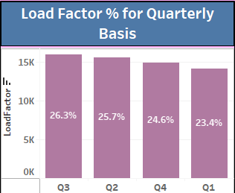
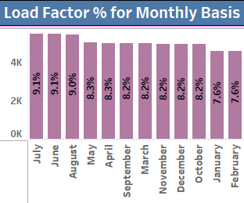
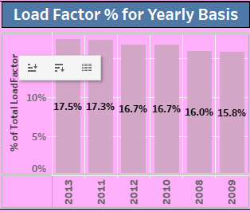
Find the load Factor percentage on a yearly, Quarterly, Monthly basis
The load factor measures the percentage of available seating capacity filled with passengers.
A high load factor indicates a preferred airline with most seats sold.
The load factor showed growth after a stable phase in 2008-2009, peaking at `17.5% in 2013.
Despite a small dip, the trend indicates that the load factor is stabilizing around 17.5% toward the end of the period.

Slide 12
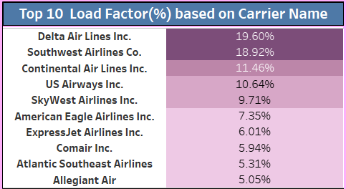
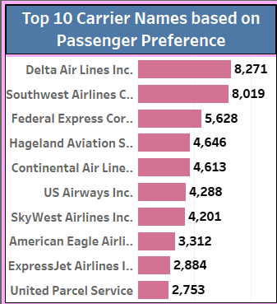
Find the load Factor percentage on a Carrier Name basis
Analyzed the total number of passengers traveling with each airline.
Identified the top 10 carrier names based on passenger count.
The top 2 airlines with the above 18% load factor dominate in terms of passenger capacity usage
There is a noticeable gap between the best performers (19.6%) and the lower end (5%)
Identify Top 10 Carrier Names Based Passengers Preference
Delta Airlines Inc. stands out significantly with the highest passenger count of 8271. This suggests it is the most preferred airline by a large margin.
United Parcel Services have the fewest passengers in the top 10 carrier name, with 2753 counts.

Slide 13
Display Top Routes based on Number of Flight
This bar chart shows the top 10 most popular flight routes based on the number of flights.
The data also shows that Atlanta, GA is a popular origin city for flights, with three routes in the top 10. The data suggests that the top 10 flight routes are primarily within the United States.

Slide 14
Identify the How Much Load Factor is occupied on Weekend vs Weekdays.
The pie chart shows that the load factor is occupied on Weekdays 71% of the time and on Weekends 29% of the time.
It is worth noting that the Weekday load factor is more than double the Weekend load factor. Further investigation could be conducted to determine the reason for this disparity.

Slide 15
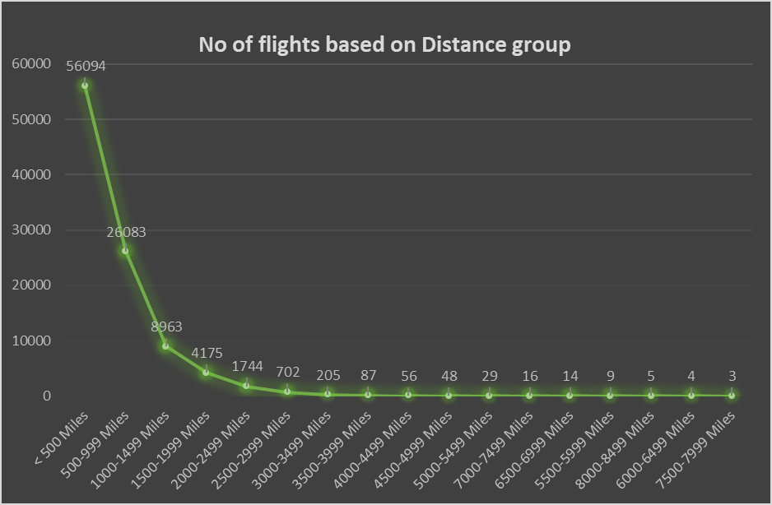
Identify number of flights based on Distance group
This KPI illustrates the distribution of flights by distance group, showing a decline in the number of flights as the distance increases. This trend can be attributed to several factors:
Higher frequency of shorter flights: Shorter flights are often preferred for business trips, visits to family and friends.
Cost implications: Longer flights tend to be more expensive for both airlines and passengers, making them less frequent.
Time considerations: The extended duration of longer flights can discourage some travelers."

Slide 16
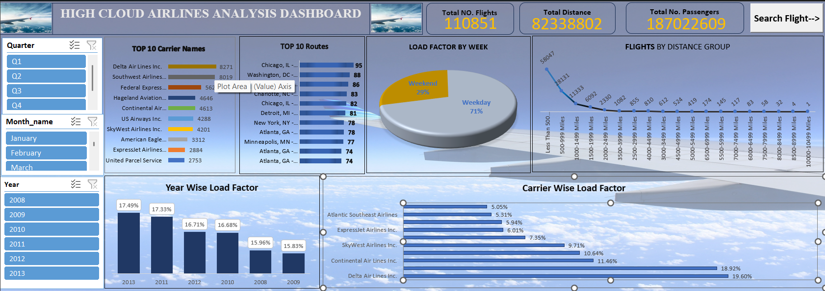
EXCEL DASHBOARD

Slide 17
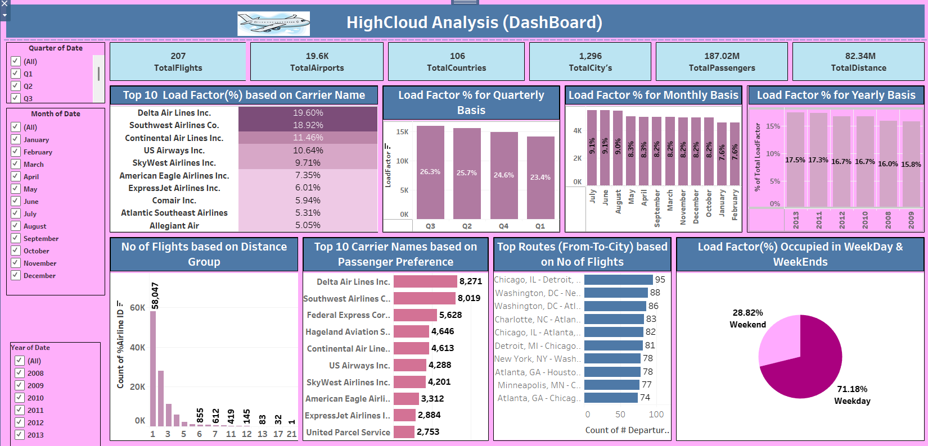
TABLEAU DASHBOARD

Slide 18
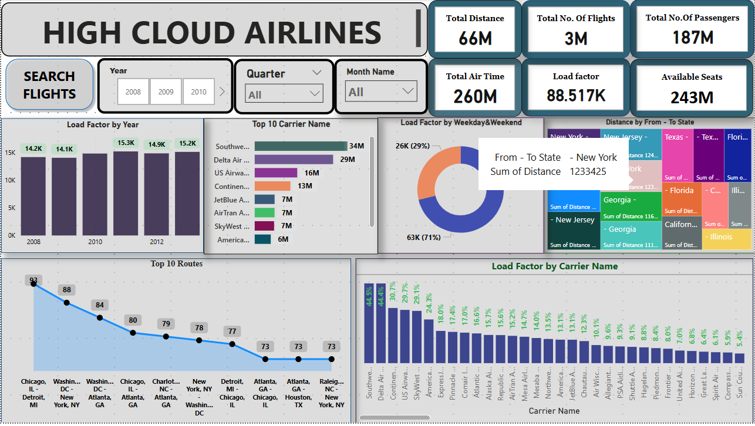
POWER BI DASHBOARD

Slide 19
Recommendations
● Optimize Flight Routes: Utilize Insights From Top Routes And Flights To Optimize Schedule And Resource Allocation.
● Enhance Load Factor: Leverage Load Factor Analysis To Identify Trends And Implement Strategies For Increased Efficiency.
● Strategic Carrier Partnerships: Collaborate With Top Carriers To Maximize Passengers Transportation And Enhance Overall Performance.
● Resource Allocation: Allocate Resources Strategically Based On Flight Schedules And Passengers Volume Data. This Ensures Efficient Operations And Minimizes Wait Times At Airports With High Passenger Traffic.

Slide 20
Conclusion
High cloud analysis equips the aviation industry with valuable insights, driving operational efficiency and supporting informed strategic decisions.
The outlined KPIs highlight the significant opportunities for advancement and expansion within the industry.
Empowering change through data-driven insights, we can set the stage for a brighter future for High Cloud Analysis and its collaborators in aviation.

Slide 21
THANK YOU

